Slide 1

Unit-III
Clustering
Course In-Charges:
Dr.A.Mary Posonia
Dr.B.Ankayarkanni
SIT1305 Machine Learning

Slide 2
Clustering
Clustering or cluster analysis is a machine learning technique, which groups the unlabelled dataset.
It can be defined as "A way of grouping the data points into different clusters, consisting of similar data points. The objects with the possible similarities remain in a group that has less or no similarities with another group.“
Finding some similar patterns in the unlabelled dataset such as shape, size, color, behavior, etc., and divides them as per the presence and absence of those similar patterns.
SIT1305 Machine Learning

Slide 3
Clustering
It is an unsupervised learning method, hence no supervision is provided to the algorithm, and it deals with the unlabeled dataset.
After applying this clustering technique, each cluster or group is provided with a cluster-ID. ML system can use this id to simplify the processing of large and complex datasets.
The clustering technique is commonly used for statistical data analysis.
Note: Clustering is somewhere similar to the classification algorithm, but the difference is the type of dataset that we are using. In classification, we work with the labeled data set, whereas in clustering, we work with the unlabelled dataset.
SIT1305 Machine Learning

Slide 4
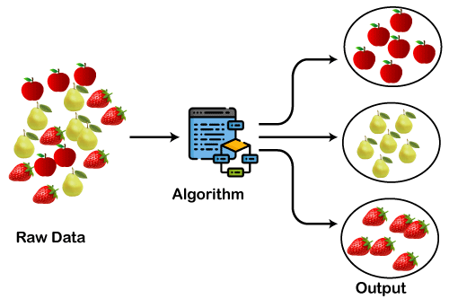
The below diagram explains the working of the clustering algorithm. We can see the different fruits are divided into several groups with similar properties.
SIT1305 Machine Learning

Slide 5
Applications of Clustering
In Identification of Cancer Cells: The clustering algorithms are widely used for the identification of cancerous cells. It divides the cancerous and non-cancerous data sets into different groups.
In Search Engines: Search engines also work on the clustering technique. The search result appears based on the closest object to the search query. It does it by grouping similar data objects in one group that is far from the other dissimilar objects. The accurate result of a query depends on the quality of the clustering algorithm used.
SIT1305 Machine Learning

Slide 6
Applications of Clustering
Customer Segmentation: It is used in market research to segment the customers based on their choice and preferences.
In Biology: It is used in the biology stream to classify different species of plants and animals using the image recognition technique.
In Land Use: The clustering technique is used in identifying the area of similar lands use in the GIS database. This can be very useful to find that for what purpose the particular land should be used, that means for which purpose it is more suitable.
SIT1305 Machine Learning

Slide 7
The clustering technique can be widely used in various tasks. Some most common uses of this technique are:
  Market Segmentation
  Statistical data analysis
  Social network analysis
  Image segmentation
  Anomaly detection, etc.
Apart from these general usages, it is used by the Amazon in its recommendation system to provide the recommendations as per the past search of products.
Netflix also uses this technique to recommend the movies and web-series to its users as per the watch history.
SIT1305 Machine Learning

Slide 8
Unsupervised learning: no predefined classes
A good clustering method will produce high quality clusters
  high intra-class similarity: cohesive within clusters
  low inter-class similarity: distinctive between clusters
The quality of a clustering method depends on
  the similarity measure used by the method
  its implementation, and
  its ability to discover some or all of the hidden patterns.
  Clustering is a form of learning by observation rather than learning by examples.
SIT1305 Machine Learning

Slide 9
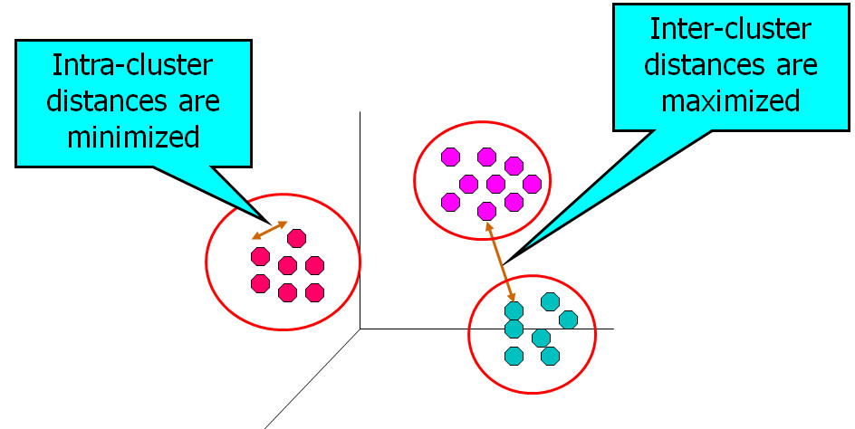
Main objectives of clustering are:
Intra-cluster distance is minimized.
Inter-cluster distance is maximized.
SIT1305 Machine Learning

Slide 10
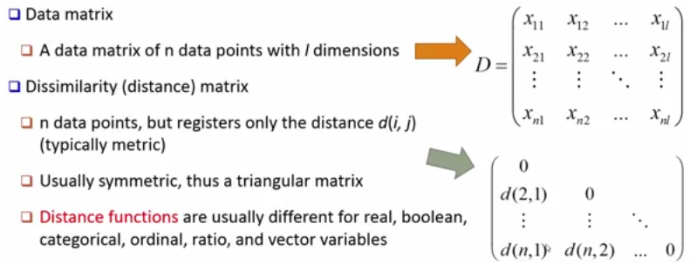
Data Matrix and Dissimilarity Matrix
SIT1305 Machine Learning

Slide 11
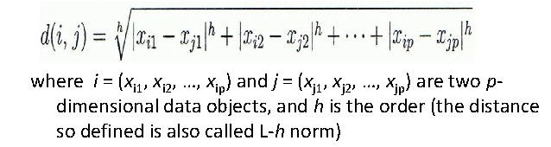
Similarity and Dissimilarity
Distances are normally used to measure the similarity or dissimilarity between to data objects.
Some popular distances are based on Minkowski distance(Lp or Lh norm)
SIT1305 Machine Learning

Slide 12
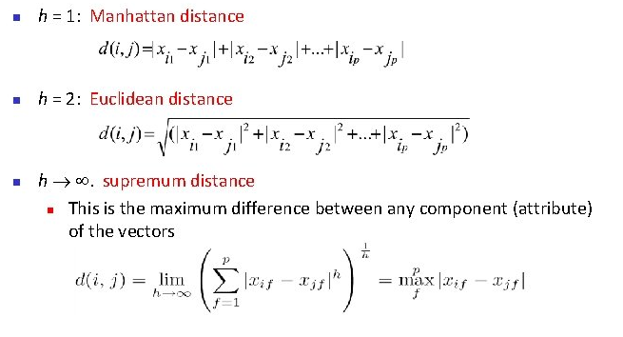
Special cases of Minkowski Distance
SIT1305 Machine Learning

Slide 13
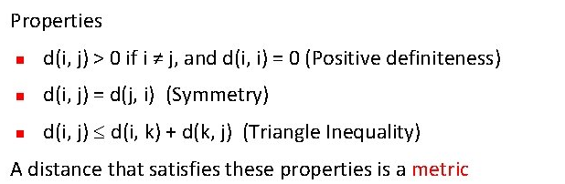
SIT1305 Machine Learning

Slide 14
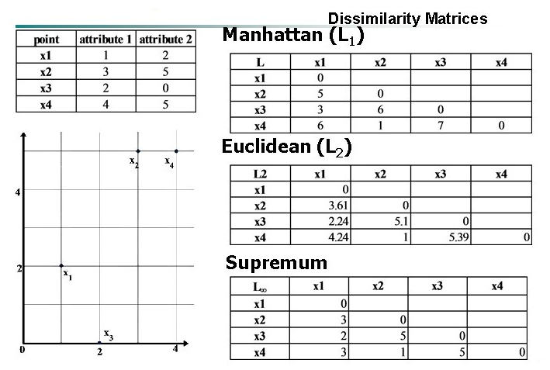
Example
SIT1305 Machine Learning

Slide 15
Problem 1
Given two objects represented by the tuples (22, 1, 42, 10) and (20, 0, 36, 8):
  Compute the Euclidean distance between the two objects.
  Compute the Manhattan distance between the two objects.
  Compute the Minkowski distance between the two objects using q=3.
SIT1305 Machine Learning

Slide 16
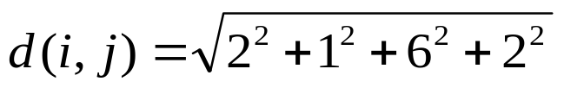

Compute the Euclidean distance between the two objects.
(22, 1, 42, 10) and (20, 0, 36, 8)
SIT1305 Machine Learning

Slide 17
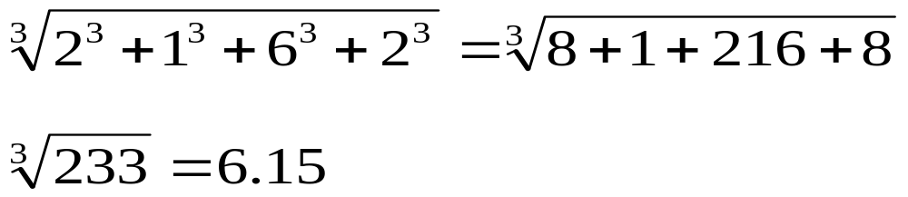
2. Compute the Manhattan distance between the two objects.
= 2+1+6+2
= 11
3. Compute the Minkowski distance between the two objects using q=3.
SIT1305 Machine Learning

Slide 18
Problem 2
Given 5-dimensional numeric samples A=(1,0,2,5,3) and B=(2,1,0,3,-1).
  Compute the Euclidean distance between the two objects.
  Compute the Manhattan distance between the two objects.
  Compute the Supremum distance.
SIT1305 Machine Learning

Slide 19
Types of Clustering Methods
The clustering methods are broadly divided into Hard clustering (datapoint belongs to only one group) and Soft Clustering (data points can belong to another group also).
But there are also other various approaches of Clustering exist. Below are the main clustering methods used in Machine learning:
  Partitioning Clustering
  Density-Based Clustering
  Distribution Model-Based Clustering
  Hierarchical Clustering
  Fuzzy Clustering
SIT1305 Machine Learning

Slide 20
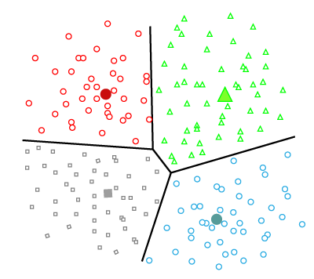
Partitioning Clustering
It is a type of clustering that divides the data into non-hierarchical groups. It is also known as the centroid-based method. The most common example of partitioning clustering is the K-Means Clustering algorithm.
In this type, the dataset is divided into a set of k groups, where K is used to define the number of pre-defined groups. The cluster center is created in such a way that the distance between the data points of one cluster is minimum as compared to another cluster centroid.
SIT1305 Machine Learning

Slide 21
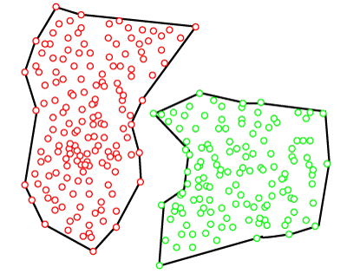
Density-Based Clustering
The density-based clustering method connects the highly-dense areas into clusters, and the arbitrarily shaped distributions are formed as long as the dense region can be connected.
This algorithm does it by identifying different clusters in the dataset and connects the areas of high densities into clusters. The dense areas in data space are divided from each other by sparser areas.
These algorithms can face difficulty in clustering the data points if the dataset has varying densities and high dimensions.
SIT1305 Machine Learning

Slide 22
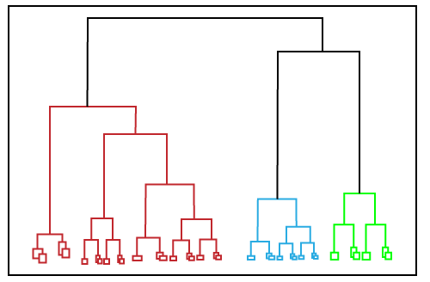
Hierarchical Clustering
Hierarchical clustering can be used as an alternative for the partitioned clustering as there is no requirement of pre-specifying the number of clusters to be created.
In this technique, the dataset is divided into clusters to create a tree-like structure, which is also called a dendrogram.
The observations or any number of clusters can be selected by cutting the tree at the correct level. The most common example of this method is the Agglomerative Hierarchical algorithm.
SIT1305 Machine Learning

Slide 23
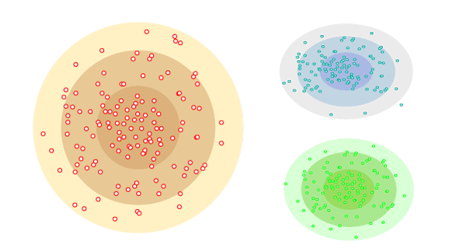
Distribution Model-Based Clustering
In the distribution model-based clustering method, the data is divided based on the probability of how a dataset belongs to a particular distribution. The grouping is done by assuming some distributions commonly Gaussian Distribution.
The example of this type is the Expectation-Maximization Clustering algorithm that uses Gaussian Mixture Models (GMM).
SIT1305 Machine Learning

Slide 24
Fuzzy Clustering
Fuzzy clustering is a type of soft method in which a data object may belong to more than one group or cluster.
Each dataset has a set of membership coefficients, which depend on the degree of membership to be in a cluster.
Fuzzy C-means algorithm is the example of this type of clustering; it is sometimes also known as the Fuzzy k-means algorithm.
SIT1305 Machine Learning

Slide 25
Major Clustering Methods
1. Partitioning Clustering Method
Given a database of n objects or data tuples , a partitioning method constructs k partitions of the data , where each partition represents a cluster and k<=n.
k is the number of groups after the classification of objects. There are some requirements which need to be satisfied with this Partitioning Clustering Method :
  Each group must contain at least one object
  Each object must belong to exactly one group.
There is one technique called iterative relocation, which means the object will be moved from one group to another to improve the partitioning.
SIT1305 Machine Learning

Slide 26
The general criterion of a good partitioning is that object in the same clusters are “close” or related to each other , whereas objects of different clusters are “far apart” or very different.
Example:
  K-means, K--Mediods ,CLARANS
SIT1305 Machine Learning

Slide 27
2. Hierarchical Clustering Methods
In this hierarchical clustering method, the given set of an object of data is created into a kind of hierarchical decomposition.
The formation of hierarchical decomposition will decide the purposes of classification.
Hierarchical clustering algorithm is of two types:
  i) Agglomerative Hierarchical clustering algorithm or AGNES (agglomerative nesting) and.
  ii) Divisive Hierarchical clustering algorithm or DIANA (divisive analysis).
  Both this algorithm are exactly reverse of each other.
Example: BIRCH, CAMELEON
SIT1305 Machine Learning

Slide 28
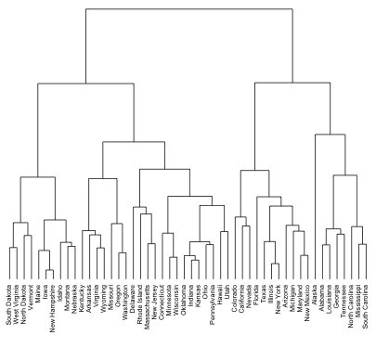
Hierarchical clustering is an alternative approach to k-means clustering for identifying groups in a data set.
In contrast to k-means, hierarchical clustering will create a hierarchy of clusters and therefore does not require us to pre-specify the number of clusters.
Hierarchical clustering has an added advantage over k-means clustering - results can be easily visualized using an attractive tree-based representation called a dendrogram.
SIT1305 Machine Learning

Slide 29
Divisive Approach
Divisive approach is a top-down approach.
Start with one,all-inclusive cluster.
Smaller clusters are created by splitting the group by using the continuous iteration.
Split until each cluster contains a point.
  Cannot undo after the group is split or merged, and that is why this method is not so flexible.
SIT1305 Machine Learning

Slide 30
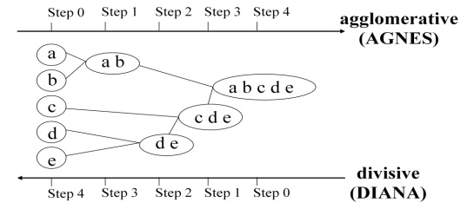
Agglomerative Approach
This approach is also known as bottom-up approach.
Start with each object forming a separate group.
It keeps on merging the objects or groups that are close to one another.
It keep on doing so until all of the groups are merged into one or until the termination condition holds.
SIT1305 Machine Learning

Slide 31
K-means Clustering
SIT1305 Machine Learning

Slide 32
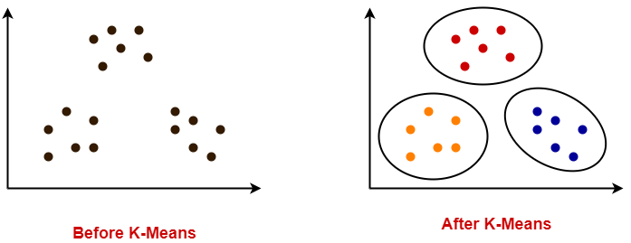
K-means Clustering Method
K-Means clustering is an unsupervised iterative clustering technique.
It partitions the given data set into k predefined distinct clusters.
It partitions the data set such that-
  Each data point belongs to a cluster with the nearest mean.
  Data points belonging to one cluster have high degree of similarity.
  Data points belonging to different clusters have high degree of dissimilarity.
SIT1305 Machine Learning

Slide 33
K-means Clustering Method
If k is given, the K-means algorithm can be executed in the following steps:
  Partition of objects into k non-empty subsets
  Identifying the cluster centroids (mean point) of the current partition.
  Assigning each point to a specific cluster
  Compute the distances from each point and allot points to the cluster where the distance from the centroid is minimum.
  After re-allotting the points, find the centroid of the new cluster formed.
SIT1305 Machine Learning

Slide 34
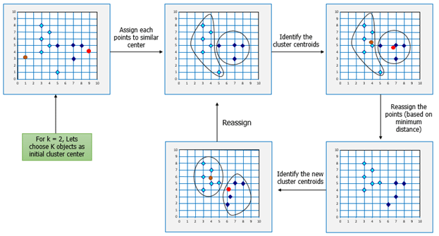
The step by step process:
SIT1305 Machine Learning

Slide 35
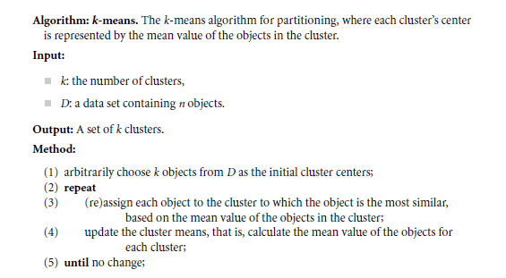
SIT1305 Machine Learning

Slide 36
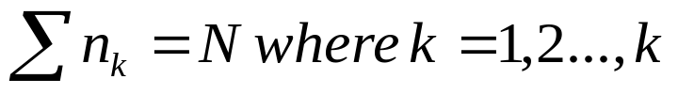
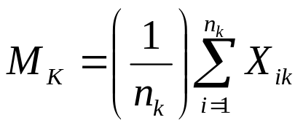
The most commonly used partitioning-clustering strategy is based on the square error criterion.
The general objective is to obtain the partition that ,for a fixed number of clusters, minimizes the total square error.
Suppose that the given dataset of N samples in an n-dimensional space has been partitioned into k-clusters {c₁ , c₂ ,... c_{k} }.
Each c_{k} has n_{k} samples and each sample has exactly one cluster, so that
The mean vector M_{K} of cluster C_{k} is defined as the centroid of the cluster
where X_{ik} is the i^{th} sample belonging to cluster C_{k}
SIT1305 Machine Learning

Slide 37
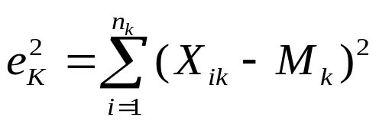
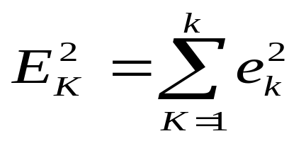
The square error for cluster C_{k} is the sum of the squared Euclidean distance between each sample in C_{k} and its centroid. This error is also called the within-cluster variation.
The square-error for the entire clustering space containing k clusters is the sum of the within-cluster variations:
SIT1305 Machine Learning

Slide 38
Example
Consider the data points X₁={1,0} X₂={0,1} X₃={2,1} X₄={3,3}
Clusters: C₁={X₁ ,X₃} C₂={X₂ ,X₄}
Apply one iteration of K-means partitioning clustering algorithm.
What is the change in total square error?
Apply second iteration of K-means partitioning clustering algorithm.
SIT1305 Machine Learning

Slide 39
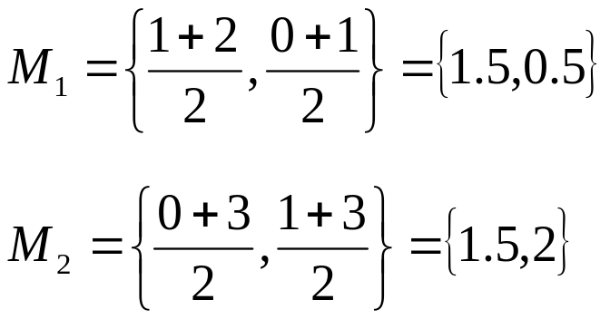
Step 1: The centroid for the clusters C₁ and C₂ are:
X₁={1,0} X₂={0,1} X₃={2,1} X₄={3,3}
Clusters: C₁={X₁ ,X₃} C₂={X₂ ,X₄}
SIT1305 Machine Learning

Slide 40
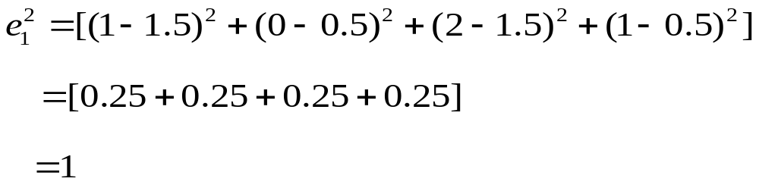
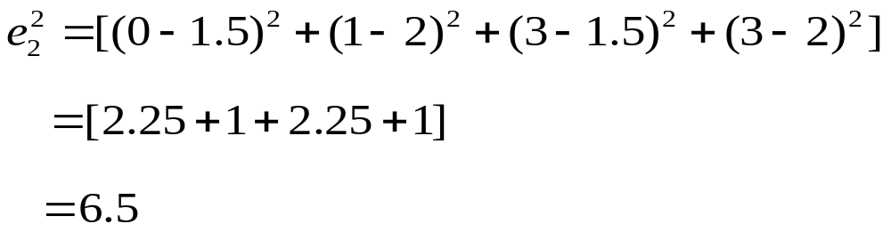
Step 2: Within cluster variation after initial random distribution of samples:
SIT1305 Machine Learning

Slide 41

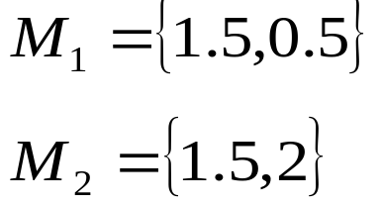
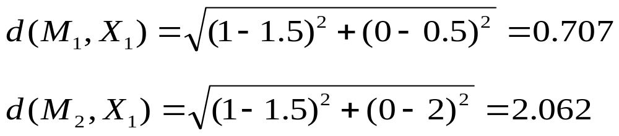
Step 3: Total square error
Reassign all samples depending on minimum distance from centroid M₁ and M₂ ,the new redistribution of samples inside clusters will be:
1. X₁={1,0}
SIT1305 Machine Learning

Slide 42
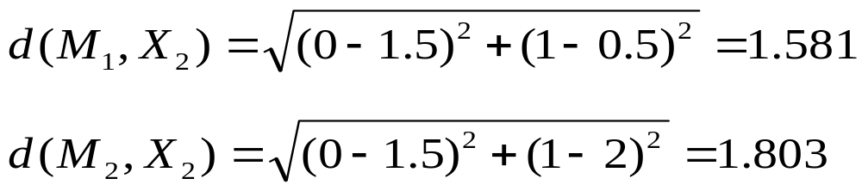
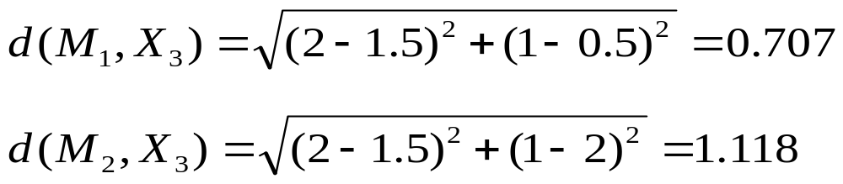
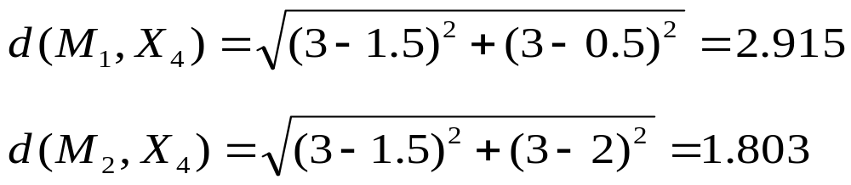
2. X₂={0,1}
X₃={2,1}
4. X₄={3,3}
SIT1305 Machine Learning

Slide 43
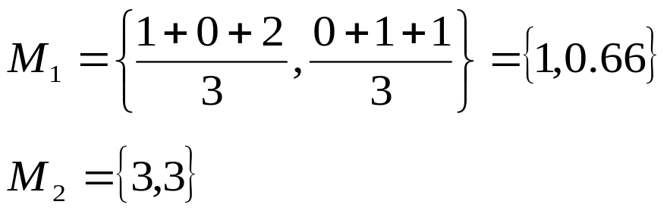
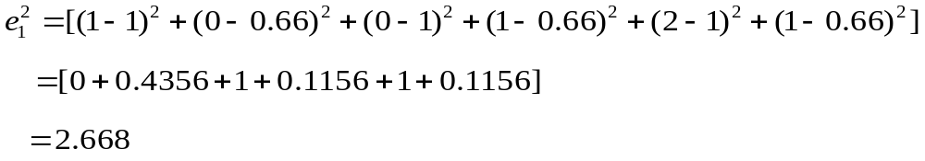
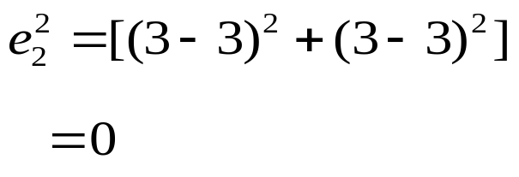
New Clusters: C₁={X₁ , X₂ ,X₃} C₂={X₄}
SIT1305 Machine Learning

Slide 44

Total square error
After first iteration, the total square error is significantly reduced from the value 7.5 to 2.668.
SIT1305 Machine Learning

Slide 45
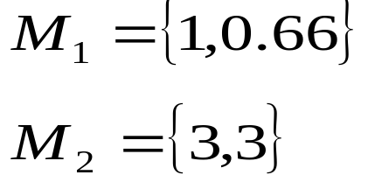
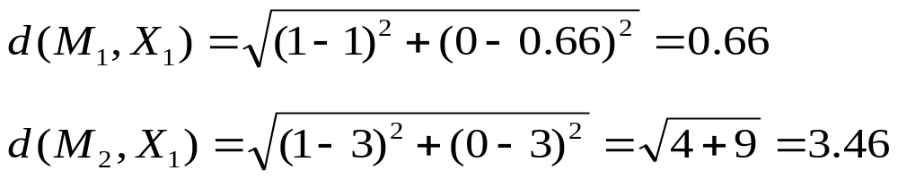
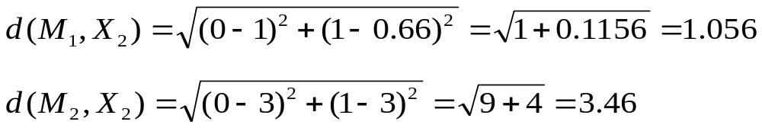
New centroids:
X₁={1,0}
X₂={0,1}
SIT1305 Machine Learning

Slide 46
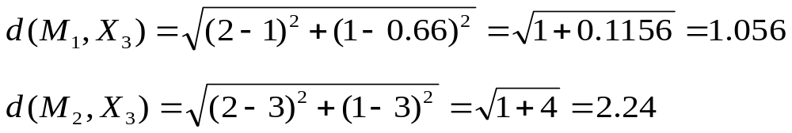
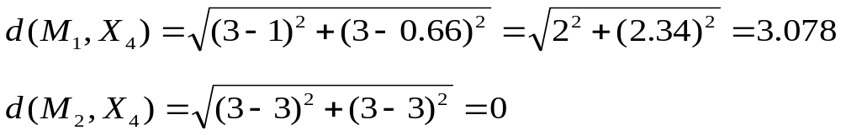
3. X₃={2,1}
X₄={3,3}
Clusters: C₁={X₁ , X₂ ,X₃} C₂={X₄}
There is no reassignment and therefore the algorithm halts.
SIT1305 Machine Learning

Slide 47
Advantages:
  With large number of variables, k-means may be computationally faster that hierarchical clustering(if k is small).
  K-means may produce tighter clusters that hierarchical clustering especially is the cluster are globular.
Disadvantages:
  Difficult in comparing the quality of the clusters produced.
  Applicable only when mean is defined.
  Need to specify k, the number of clusters in advance.
  Unable to handle noisy data and outliers.
SIT1305 Machine Learning

